Slide 1
Topic detection using paragraph vectors to support active learning in Systematic Reviews
How Robot Analyst Reduces Sunk Time in Systematic Reviews
Luke Sturgeon

Slide 2
Presentation Overview
Explain why tool is necessary
What it generally does
How it works
Proof that it works
Summary

Slide 3
Why it’s a thing
Systematic reviews are massive
Have to invest multiple peoples’ time into reviewing
Need more than one person for interrater reliabilities
Personal Experience: Mind-numbing
Accuracy of classification decreases
i.e. vigilance task

Slide 4
Overview
Take a list of unclassified abstracts, list of eligible abstracts, list of ineligible abstracts and upload to server
01
RA arranges the unclassified abstracts in order of most to least likely to be eligible (black box)
02
Human goes through list and classifies abstracts as eligible/ineligible
03
RA updates order of inclusion as user classifies articles within the website
04

Slide 5
The process, Step 1
Get a massive list of articles and their abstracts
40,000+ in one systematic review
Take small sample and classify them yourself
Suggested 30 articles for each classification (eligible/ineligible)
Arrange abstracts in appropriate file format
R code into bibliographic file type (.ris)
Upload to RA and hope it doesn’t crash

Slide 6
The process, step 2 what the user sees
A list of abstracts in descending order of inclusion probability
Can rearrange things, change colors, look at common words, it’s really very nice
Demo later

Slide 7
The process, step 2 inside the black box
Paragraph vector topic detection
Word Vectors
Title and abstract of the paper go through GENIA tagger
Records the part of speech and lemma
Abstracts are put through TerMine to find multi-word phrases that are repeated through the abstract and are significant (unique) to that abstract
“Neural network models” are then used to find conditional probability that words will appear given N words before it
Attempts to capture contextual clues

Slide 8
The process, step2 inside the box
Paragraph vector topic detection cont’d
Paragraph vectors
Represent paragraphs of arbitrary length, in this case represent documents
MALLET produces topic model
Assumes each abstract is a composition of various topics
Each abstract varies in the proportion of each topic, 300 topics by default
Gives similarity measure to compare abstracts using cosine distance between topic vectors
Distance is used for document clustering later
Also creates visual aid search interface for selecting abstracts according to topics
Each topic is described by the five most frequent words found within that topic and a set of 45 abstracts that are most closely associated with it
Makes it easier to see what each “topic” is about

Slide 9
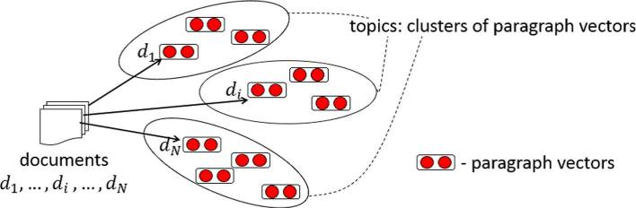
Topic detection method

Slide 10
The process, step 2 inside the black box
Clustering Abstracts
Spectral Clustering
Similarity Graph using cosine similarities between bag-of-words vector representations of abstracts and titles
TF-IDF weighting
Only uses words that appear more than five times
Determine k eigenvalues from matrix
Run k-means
Default is 10 replications of 100 iterations
Number of clusters is user defined, 5-100

Slide 11
The Process, Step 2 Inside the black box
Feature Selection
Keywords (words, lemmatized words, and phrases from TerMine) are selected
Finds words that are positively correlated with the cluster
Then uses Conditional Mutual Information Maximization criterion (CMIM) to further reduce set of keywords, eliminating redundancies introduced by dependency of words
Keywords are then ordered by weighting
Keywords of each cluster help the user see how the clusters have been formed
Which words have been associated with a cluster

Slide 12
The Process, step 2 inside the black box
Abstracts are sorted by inclusion confidence
Very vague on how they find this, just mention “binary classification model”
Uses the TF-IDF scores of lemmatized words in the title and abstract, and the topic proportion vector from the LDA model
Past screening decisions are used to train linear model through LIBLINEAR
Uses logistic regression model and linear Support Vector Machines
Models are used to classify the unclassified list of abstracts

Slide 13
The process, step 3
User marvels at not having to do this themselves
Goes through list of abstracts and selects if they should be included in the final review or not

Slide 14
The process, step 4 fiddling with the black box
The logistic and SVM models are updated in LIBLINEAR after a user specifies more abstracts to be included or not
Model is re-trained with the additionally classified abstracts

Slide 15
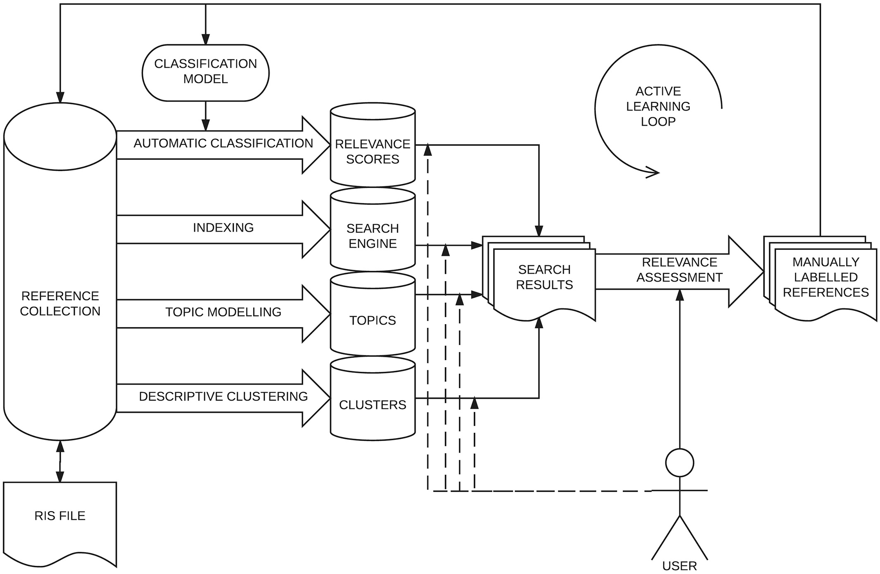
The process

Slide 16
Performance measures
Use two measures, yield and burden
Yield is the percentage of studies identified by RA
Burden is the percentage of studies labeled by the user
Also use WSS@95%
1 – Burden
Percentage of ineligible citations that can be automatically excluded when RA has achieved 95% recall performance

Slide 17
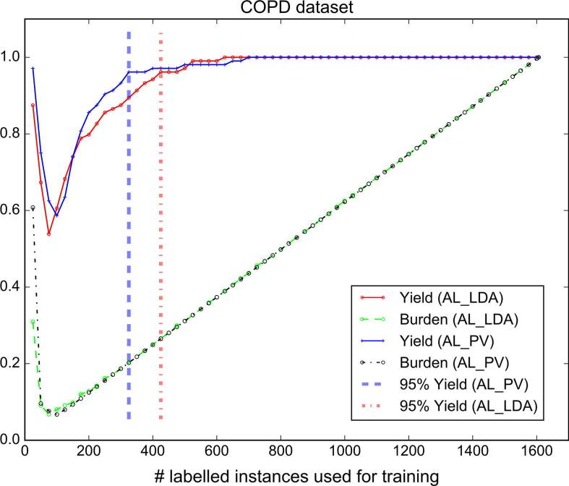
Performance measures

Slide 18
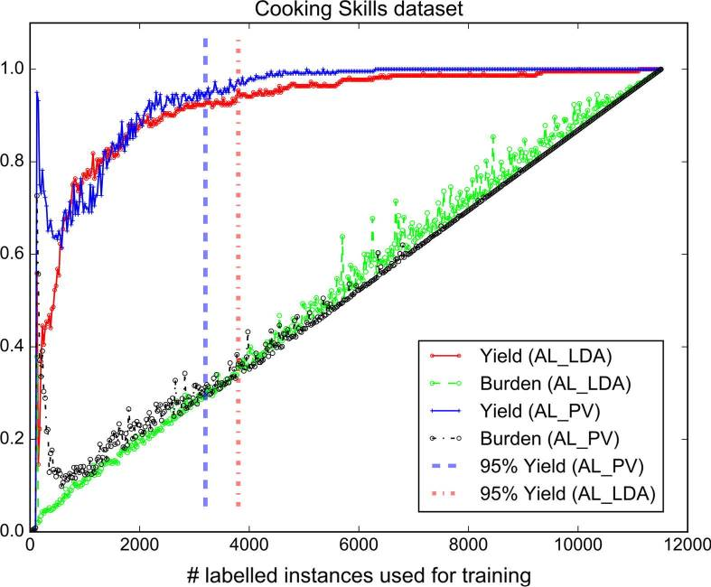
Performance measures

Slide 19
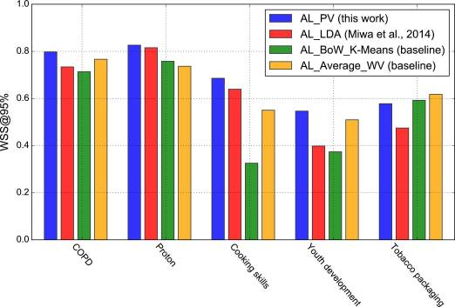
Performance measures

Slide 20
summary
Study concludes the addition of paragraph vector based topic detection model reduces manual annotation more than previous methods
More pronounced in health related topics
Gains are between 5-15% in terms of WSS@95%

Slide 21
References
Fleuret, François. "Fast binary feature selection with conditional mutual information." Journal of Machine Learning Research 5.Nov (2004): 1531-1555.
Hashimoto, Kazuma, et al. "Topic detection using paragraph vectors to support active learning in systematic reviews." Journal of biomedical informatics 62 (2016): 59-65.
Przybyła, P., Brockmeier, A. J., Kontonatsios, G., Le Pogam, M. -A., McNaught, J., von Elm, E., Nolan, K. and Ananiadou, S. (2018). Prioritising references for systematic reviews with RobotAnalyst: a user study.

